Slide 1
Meridiandesign.com
My goal with this presentation is to give you guys (and wave-equation) what I think the flavor of the website should be; Simple, crisp, clean, buildable and updateable.
These are not all the pages, but enough to establish a mood and give them the idea to run with.
I am showing two slides per idea. One to just see it and one with comments.

Slide 2
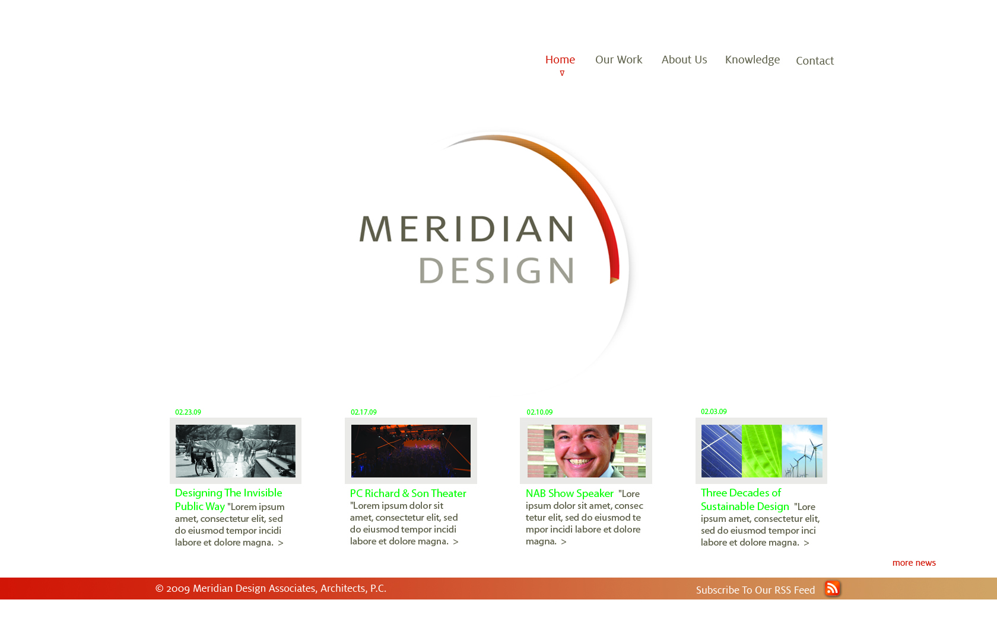
Home Option 1

Slide 3
Home Option 1
Simple logo animation.
When we add news or make any updates, it would reflect here.
Instead of logging in (except for collaboration)
We can have guests subscribe.

Slide 4
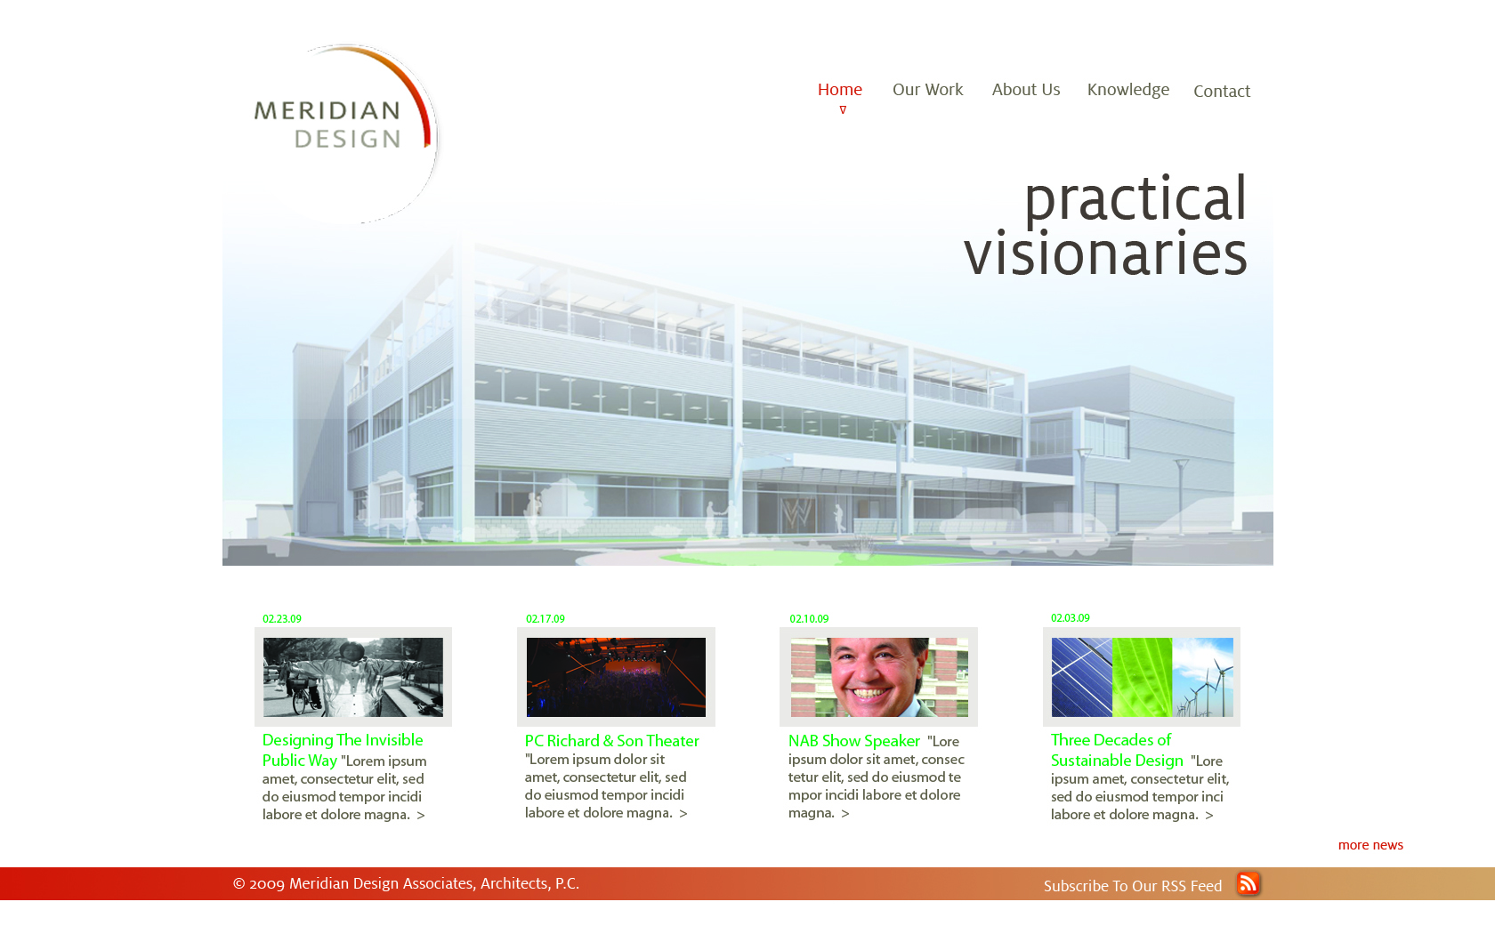
Home Option 2

Slide 5
Home Option 2
I don’t like this
Now that I see it.
Pop-ups around this
Tag line don’t seem
To work for me.
Those services can
Be on the “About
Us” page.

Slide 6
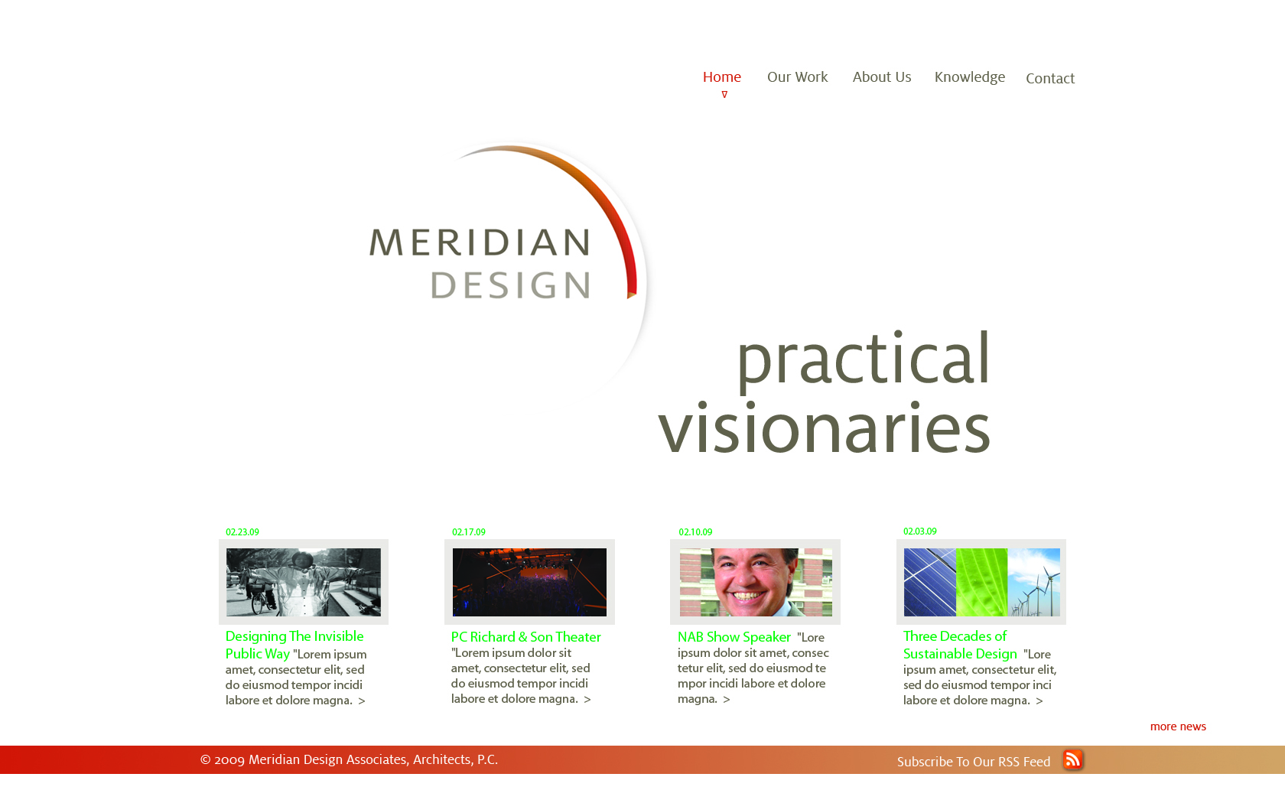
Home Option 3

Slide 7
Home Option 3
Me thinks this has the
Most potential.

Slide 8
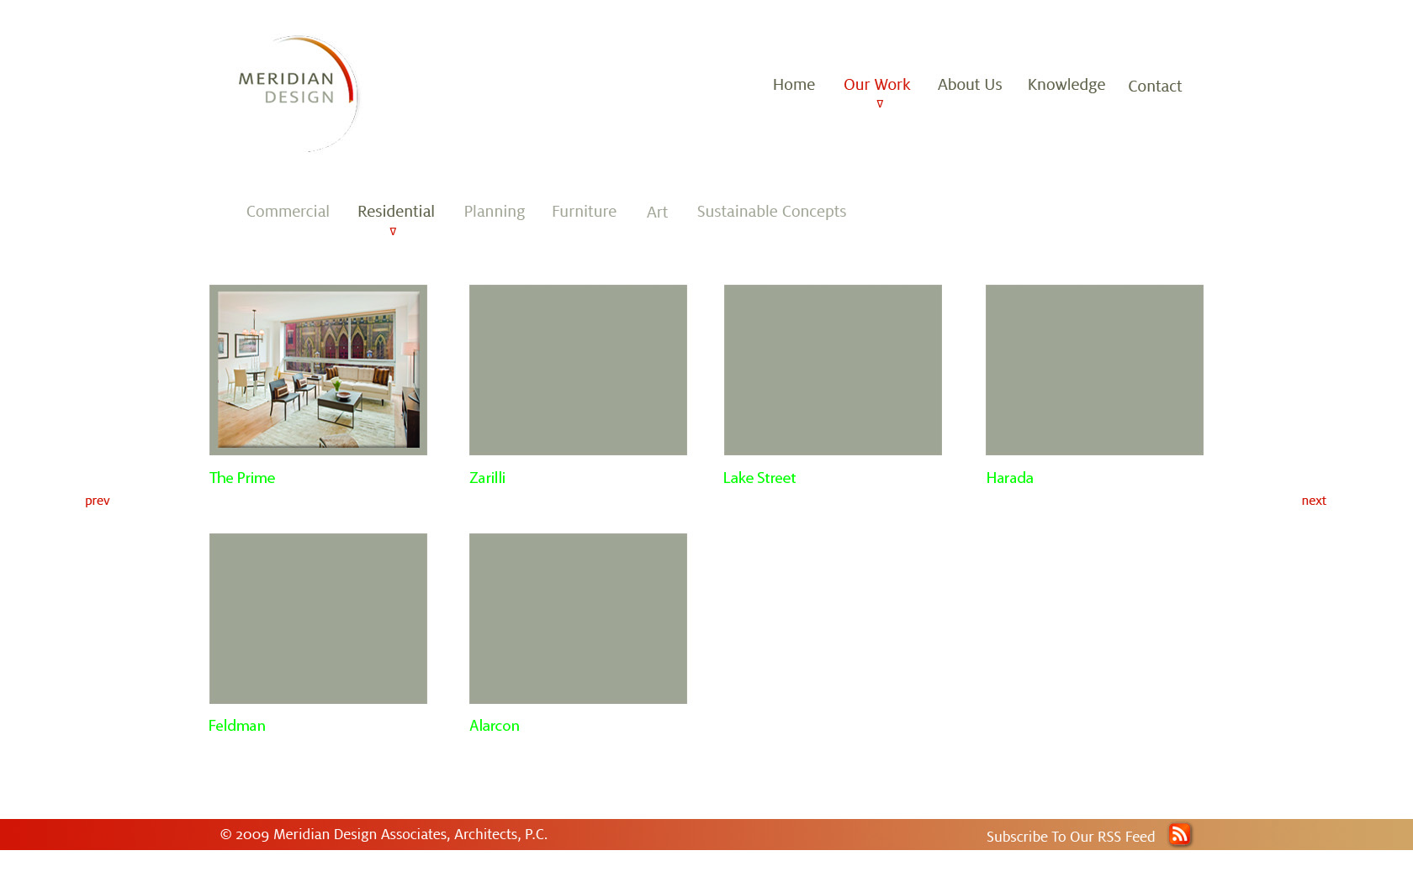
Our Work

Slide 9
Our Work
This would
Expand into
A “filmstrip” or
Similar.

Slide 10
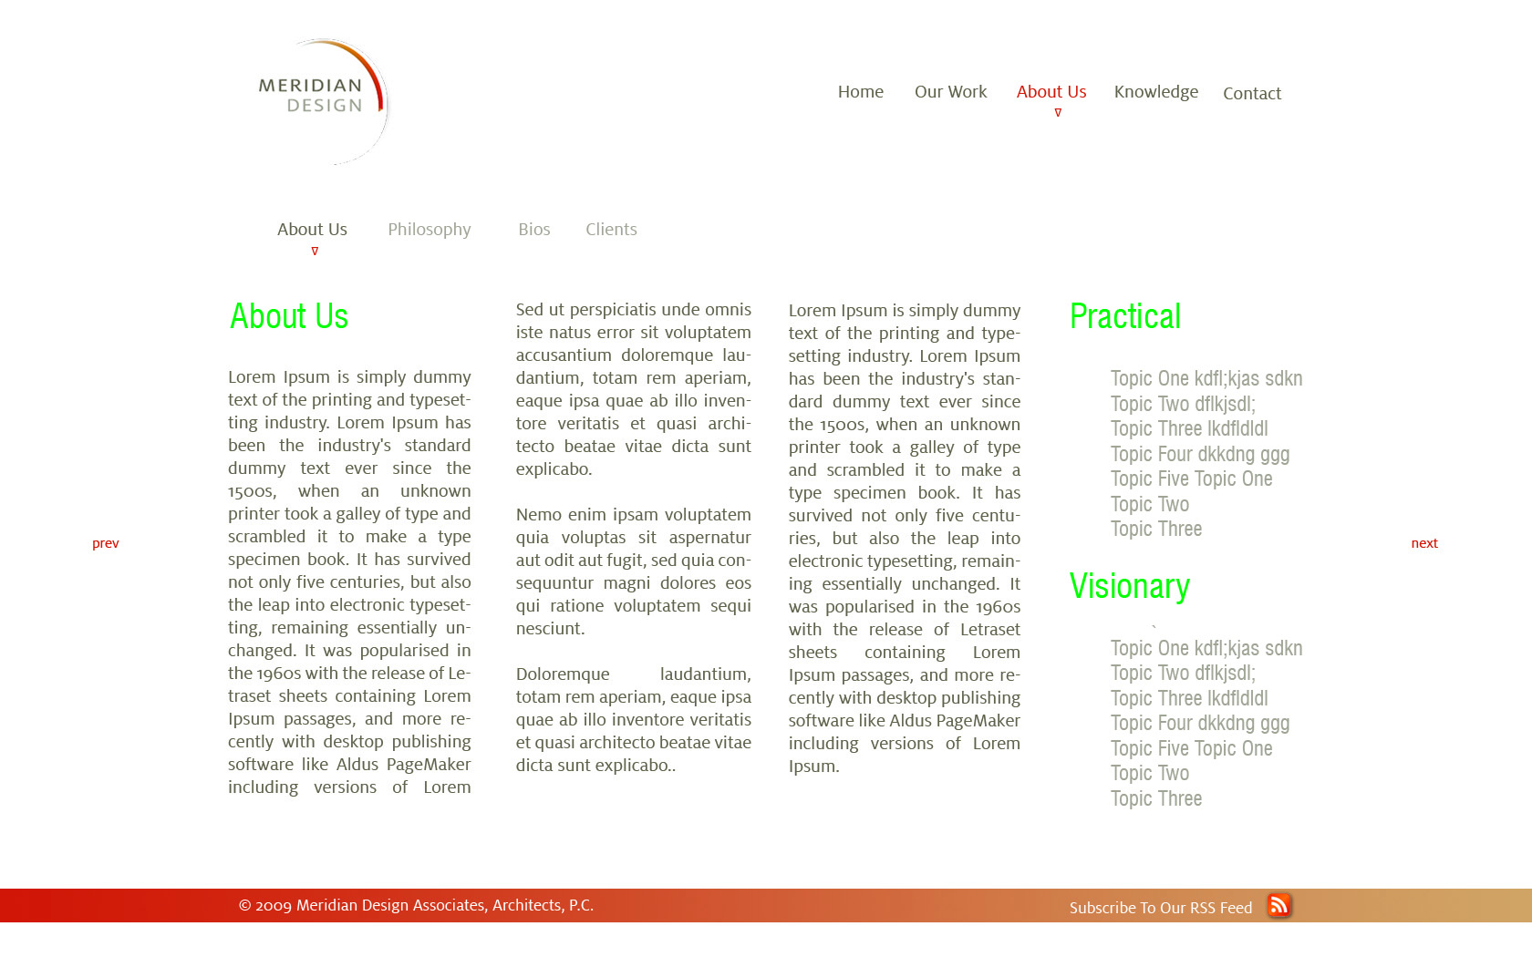
About Us/Philosophy/Bios, etc

Slide 11
About Us/Philosophy/Bios, etc
These are our text-rich
Pages(s). We can add images,
Et cetera as we go along.

Slide 12
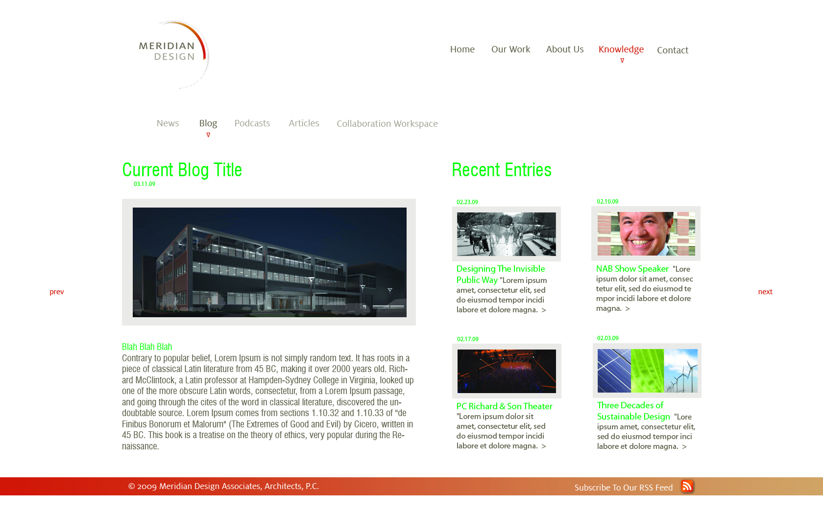
News, Blog, Podcast, Articles, etc

Slide 13
News, Blog, Podcast, Articles, etc
I “borrowed” this from a website I like. I think it is crisp and clean and it can be used for our news and blogs and more…

